Slide 1

UPI - FRAUD DETECTION
Securing Digital Payments in India
Presented By:
A Harshini-2203A52134
G Jeevan - 2203A52150
B Manisai - 2203A52136
S Pavan - 2203A52177
U Vignesh - 2203A52184

Slide 2
The Challenge The Problem: A Real-World Threat
The Rise of UPI Fraud
UPI (Unified Payments Interface) fraud, particularly through fake screenshots, has become a significant and growing threat in India's digital payment landscape. Scammers exploit busy
merchants, leading to substantial financial losses.
How Scammers Operate
Fraudsters manipulate payment confirmation screenshots to deceive
merchants into believing a transaction was successful. Merchants, often
dealing with high volumes of
customers, lack the time to verify every transaction through their bank
applications.
Social Engineering at Play
This type of fraud is a classic example of social engineering. The high-tech
security measures of banks are bypassed because the vulnerability lies
with the human element – the
merchant being tricked – rather than the banking system itself.

Slide 3
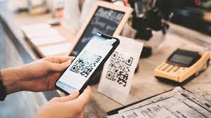

Understanding the Vulnerability The "Security Gap" We Found
Bank App is Too Slow
SMS Alerts are Unreliable
Merchants simply cannot afford the time to log into their bank app for real-time verification of every single customer transaction. This creates an operational bottleneck.
SMS notifications from banks are prone to delays due to network issues or can be easily missed in a fast-paced retail environment, offering a false sense of security.
Human Trust is Exploited
The scam capitalizes on a busy merchant's quick glance and inherent trust. Our system is designed to provide an instant, trustworthy second opinion, filling this crucial gap.

Slide 4

Our Solution: "UPI-Shield"
A Secure, Full-Stack Web Application with a Hybrid AI Engine
Our Response
Hybrid AI
Beyond simple image analysis, our AI leverages both Computer Vision (CNN for visual integrity) and Optical Character Recognition (OCR for textual accuracy). It doesn't just "look" at the image; it SEES and READS.
Full-Stack
Developed as a comprehensive web application using Python (Flask), ensuring a seamless and integrated user experience from end to end.
Secure by Design
Equipped with robust user registration and login functionalities. All passwords are securely hashed, and sensitive data is protected, adhering to best security practices.
Instant & Clear
Provides a conclusive "Real" or "Fake" verdict almost instantaneously, based on a sophisticated blend of both visual and textual analysis, giving merchants immediate clarity.

Slide 5
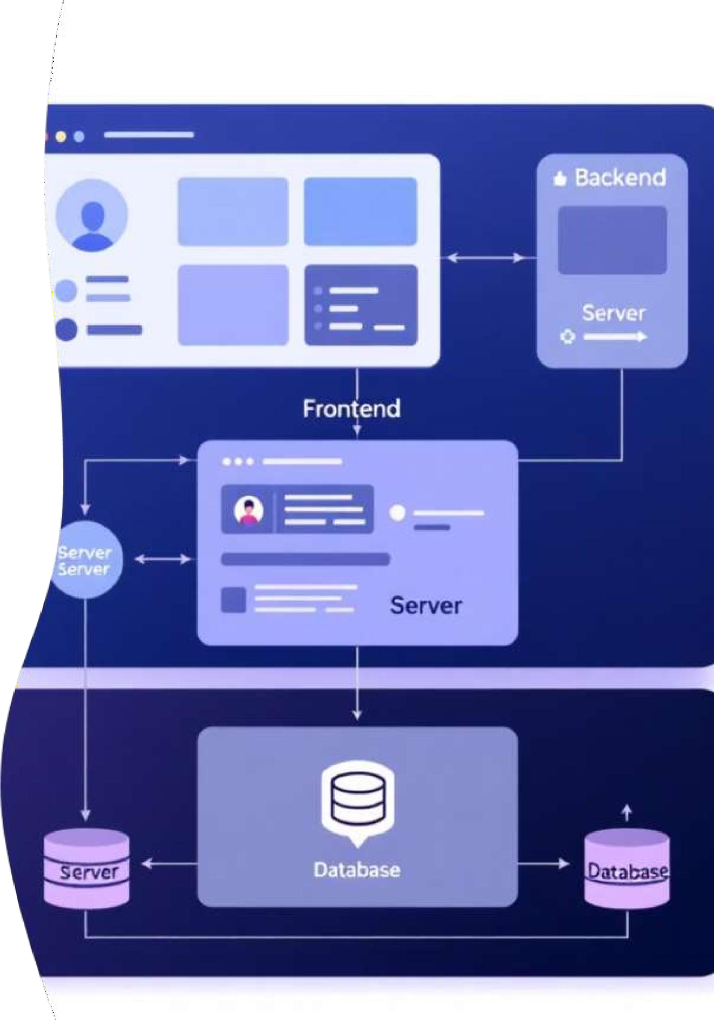





01 02
Presentation Tier (Frontend)
Logic Tier (Backend)
The user-facing interface, built with modern web technologies: Bootstrap 5 for responsive design, HTML for structure, and JavaScript for interactive elements.
The core "engine" of UPI-Shield, powered by Flask. This tier manages user accounts, handles security protocols, processes API requests, and orchestrates both the CNN and OCR models for fraud detection.
03
Data Tier (Storage)
The core "engine" of UPI-Shield, powered by Flask. This tier manages user accounts, handles security protocols, processes API requests, and orchestrates both the CNN and OCR models for fraud detection.

Slide 6
The "Hybrid Brain" - Part 1: The CNN
The Core Intelligence
Role: Visual Artifact Detection
Technique: Transfer Learning with MobileNetV3
The Convolutional Neural Network (CNN) is specifically tasked with identifying visual anomalies that betray a forged screenshot. It looks for inconsistencies imperceptible to the human eye.
We utilize Transfer Learning with MobileNetV3, a highly efficient and lightweight CNN architecture. This allows for rapid and accurate processing without requiring extensive computational resources.
The CNN acts as an "expert" in spotting digital imperfections. It meticulously analyzes:
Subtle pixel noise changes: Inconsistencies that indicate image manipulation.
Mismatched image compression: Variations in compression patterns suggesting edited sections.
Unnatural edges: Sharp or irregular boundaries caused by pasting new text or elements onto the original image.

Slide 7
The "Hybrid Brain" - Part 2: The OCR
The Core Intelligence
Role: Logical Error Detection
Technique: Tesseract OCR
The Optical Character Recognition (OCR) component's primary function is to identify logical inconsistencies within the text extracted from the screenshot, catching errors that visual inspection might miss.
We employ Tesseract OCR, a powerful open-source engine, to accurately "read" and extract textual data from the UPI transaction screenshots.
After extracting the text, we apply a rule-based check to validate key transaction details:
UTR/Transaction ID Validation: Verifying the existence and format of the Unique Transaction Reference (UTR) or Transaction ID.
Format Check: Ensuring the UTR adheres to standard formats (e.g., a 12-digit numeric sequence).
Date Verification: Crucially, checking that the transaction date is not a future date – a common logical flaw in fake screenshots.
While a scammer might create a visually flawless fake, they often make logical mistakes in the data, which our OCR and rule engine are designed to catch.

Slide 8






Phase 1: Data Pipeline & Training.
Building the Foundation
A critical challenge was the absence of a public dataset for "fake UPI screenshots," necessitating a bespoke data generation process.
We meticulously gathered over 50 real and diverse UPI screenshots from popular platforms like GPay and PhonePe to form our authentic data base.
To ensure privacy and compliance, all Personally Identifiable Information (PII) such as names and UTRs were manually redacted from the collected real screenshots.
Step 3: Generation
Step 4: Training
Utilizing an OpenCV (cv2) script, we programmatically generated over 250 "fake" screenshots. These fakes were strategically designed with both visual and logical flaws, including manipulated text and invalid UTRs, to challenge our AI.
The CNN (MobileNetV3) was rigorously trained on this synthesized dataset for 15 epochs, leveraging the power of PyTorch and a Google Colab GPU for accelerated learning.

Slide 9

The Application's Backbone
Phase 2: The "Body" - Backend
Building the Server with Flask
The backend, powered by the lightweight Python web framework Flask, serves as the central processing unit for UPI-Shield, orchestrating all critical operations.
Web Server: Responsibly serves all static and dynamic HTML pages, including the Home, Login, Profile, and Detector pages, ensuring a smooth user journey.
Fusion Logic: The backend is responsible for the sophisticated fusion of results. It combines the outputs from the CNN (e.g., "90% likelihood of being fake") and the OCR (e.g., "invalid UTR detected") to generate a single, more confident, and accurate final decision regarding the authenticity of the screenshot.
Hybrid API: We developed a dedicated /predict API route. This crucial "door" initiates the fraud detection process, intelligently routing the uploaded image through BOTH the CNN for visual analysis and the OCR engine for textual validation.

Slide 10
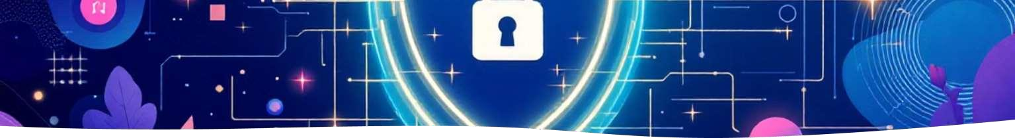



Phase 2: Security & Authentication
This is not just a demo. It's a secure application.
Protecting Our Users
site.db

Slide 11
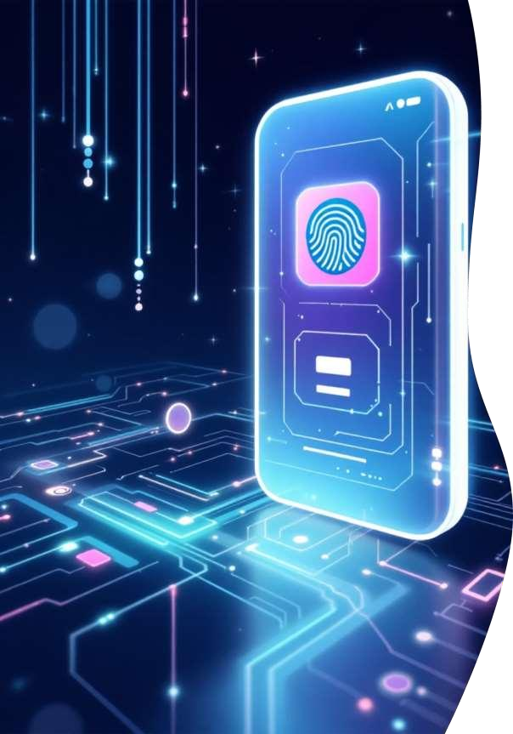
Phase 2: Reinforcing Security & Authentication
In this critical phase, we didn't just build a demo; we engineered a secure application designed to protect user data and maintain integrity.
Flask-Login
Manages user sessions, ensuring only authenticated users can access features, preventing unauthorized entry.
@login_required Decorator
Acts as a 'lock' on sensitive pages, automatically redirecting unauthenticated users to the login page for enhanced security.
Flask-SQLAlchemy
Manages our SQLite database (site.db), securely storing all user accounts and related data.
Flask-Bcrypt
Crucial for security, this library hashes passwords into an unreadable, secure format, ensuring plain-text passwords are never stored.

Slide 12


Phase 2: The User-Centric "Face" (Frontend)
Our frontend focuses on delivering a seamless and professional user experience across all devices.
Jinja2 Templating
Bootstrap
Leveraged for its robust framework, ensuring a professional, clean, and highly responsive design that adapts to both mobile and desktop views.
Utilized a base.html for consistent navigation. All other pages, such as login.html and detector.html, extend this base, ensuring a uniform look and feel throughout the application.
Dynamic JavaScript
Implemented on the detector page to facilitate asynchronous image uploads and result display, providing instant feedback without page reloads.

Slide 13
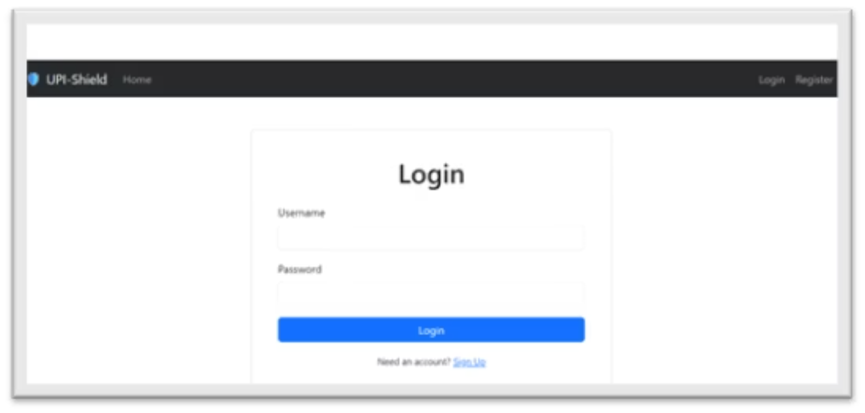
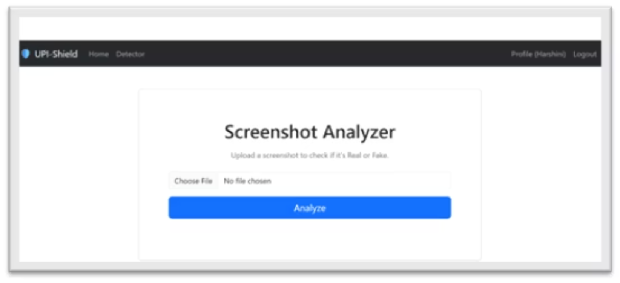
UI Showcase: Secure Login & Profile
The application is fortified with a comprehensive authentication system, demanding user registration and login for access. A dedicated profile page further confirms the user's active session and personal details.
Secure Login Interface Personalized Profile Page
Confirms successful authentication and provides a personalized user experience.
Designed for intuitive use while ensuring robust security measures.

Slide 14
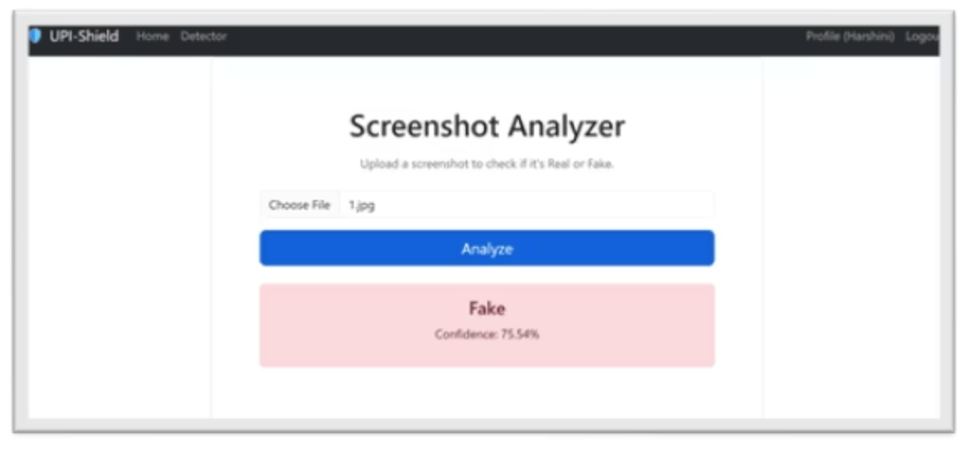
UI Showcase: The Detector in Action (FAKE)
When a user uploads a potentially forged image, our Hybrid AI swiftly analyzes it. The frontend promptly receives the "Fake" verdict from the API and displays a clear, color-coded warning to alert the user of potential fraud.
The intuitive design ensures that critical information is conveyed instantly, empowering users to make informed decisions and prevent financial losses due to fraudulent transactions.

Slide 15
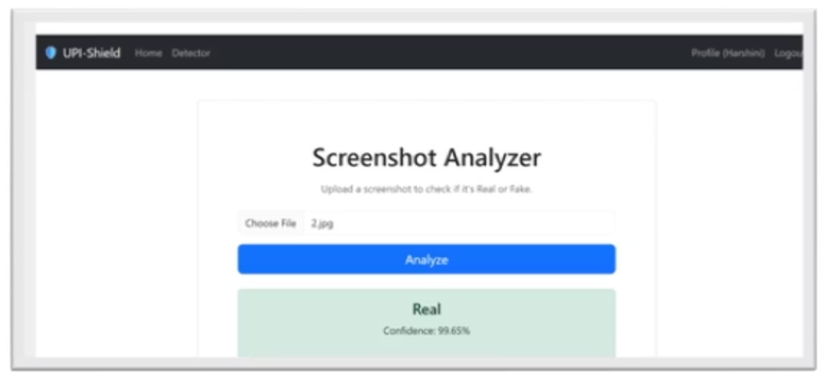
UI Showcase: The Detector in Action (REAL)
Beyond identifying fraudulent screenshots, our system is rigorously trained to validate genuine images. This capability not only confirms the model's accuracy but also builds essential user trust in its reliability and effectiveness.
A clear "REAL" verdict reassures users, demonstrating the system's ability to distinguish between authentic and fabricated content with high precision.

Slide 16


Conclusion & Key Challenges
We successfully designed and built a secure, full-stack, hybrid AI application that offers a practical solution to a significant real-world fraud problem.
Integrated Hybrid AI Solution
Overcoming Data Scarcity
The project seamlessly integrates a CNN (PyTorch) for image analysis, an OCR (Tesseract) for text extraction, a secure Flask backend, and a modern Bootstrap UI, demonstrating robust system architecture.
A major challenge was the absence of public datasets. We addressed this by meticulously building our own comprehensive dataset from scratch, a critical step for model training.
Complex System Integration
The most formidable task involved making four distinct systems—CNN, OCR, Flask Backend, and JavaScript Frontend—communicate flawlessly to deliver a single, instantaneous verdict.

Slide 17
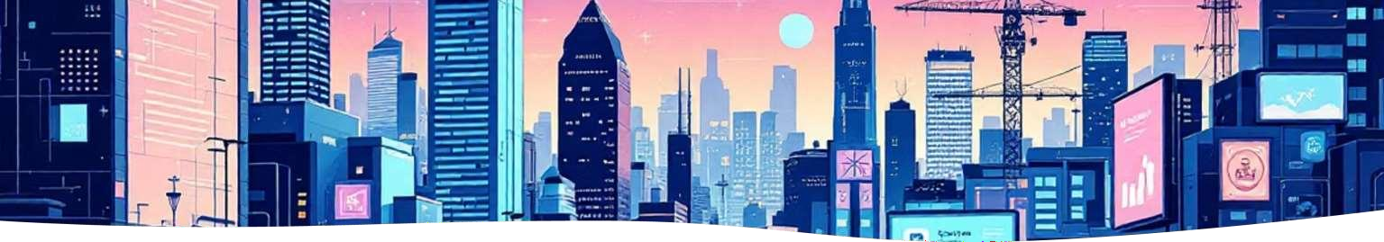
Future Scope
Our vision for the UPI fraud detection system includes exciting advancements to further enhance its capabilities and accessibility.
Live API Check
Integrate with bank APIs or third-party services to perform live checks on extracted UTR/Transaction IDs, verifying transaction authenticity in real- time.
Native Mobile App
Develop a fast and intuitive native application for Android and iOS, enabling merchants to utilize the tool on-the-go for instant fraud
detection.
Continuous Learning Mechanism
Implement a "Report New Fake" feature, allowing users to submit new forged images. This feedback loop will continuously retrain and improve the AI model's accuracy over time.

Slide 18


